Slide 1
Ethics and Requirements Engineering
Farnaz Fotrousi
Oct 2025

Slide 2

An example Scenario
Dr. Katerina is a senior requirements engineer at a global software company based in Sweden.
Katerina is responsible for gathering requirements from diverse stakeholders, including healthcare providers, patients, and regulatory bodies.
The process gathering requirements via interviews, surveys, and focus groups with these stakeholders and analysing them.
The company is developing a new software platform called "MediSync," which aims to integrate patient data from various healthcare providers to improve care coordination.
Katerina’s team is considering using advanced analytics and machine learning for analysis to process both structured and unstructured data from patient records and medical devices.
MediSync’s goal is to streamline communication between healthcare professionals and provide patients with personalized care recommendations.
Katerina plans to introduce a data-gathering system that collects real-time data from various sources, including healthcare professionals and patients

Slide 3
What Ethical Considerations should Katarina have during requirements elicitation and analysis?

Slide 4
Ethical considerations: Requirements elicitation
Confidentiality: Obligation to protect personal or sensitive information from unauthorized access
  Ensure secure storage and handling of data collected from stakeholders during elicitation activities. Use encryption and access control for data storage systems.
  Ensure that sensitive healthcare data shared by stakeholders remains confidential and is only accessible by authorized personnel.
Anonymisation: A component of confidentiality involving not collecting any data that can be used to identify subjects; not even names
  Anonymise the data collected from participants during surveys, interviews, and focus groups where possible to protect their identities.
  Avoid collecting personally identifiable information unless absolutely necessary for the requirements process.

Slide 5
Ethical considerations: Requirements elicitation
Informed Consent: The process of ensuring individuals understand the purpose, risks, and benefits of a proposed action, allowing them to voluntarily agree or decline based on transparent information (a component of confidentiality).
  Ensure all participants (patients, healthcare providers) fully understand the purpose of the requirements elicitation process.
  Obtain explicit consent for interviews, surveys, and focus groups. Inform participants of their right to withdraw at any time.
  For real-time data collection systems, clearly explain how data from patients and healthcare providers will be gathered, stored, and used.
Transparency: Openly and honestly communicating all relevant information, ensuring stakeholders are fully informed and able to make informed choices.
  Communicate openly with stakeholders about how the information gathered will be used for defining system requirements.
  Be clear about the scope and purpose of the project and the future use of the collected data, including how it may be used in development and for potential machine learning models.

Slide 6
Ethical considerations: Requirements elicitation
Data minimisation: Collecting only the data that is strictly necessary for a specific purpose
  Collect only the necessary data required for defining the requirements, avoiding excessive or intrusive data collection.

Slide 7
Ethical Considerations: Requirements analysis
Annonymisation: A component of confidentiality involving not revealing any data that can be used to identify subjects
  During analysis, patient and stakeholder data should be anonymised to prevent re-identification, particularly for unstructured data (e.g., notes from interviews).
Regulatory Compliance: refers to the adherence to laws, regulations, and guidelines relevant to an activity, ensuring that all legal standards are met
  Katerina’s team must ensure that all analysis activities comply with GDPR (in Europe) and any healthcare regulations like HIPAA (in the U.S.). Requirements analysis should align with these legal requirements to protect patient rights and privacy.

Slide 8
Ethical Considerations: Requirements analysis
Biases and fairness: Biases are unfair preferences or prejudices that can affect decisions, and fairness means treating everyone equally and making sure no one is treated unfairly.
  As machine learning algorithms are applied to analyse the collected data, Katerina’s team must be cautious of introducing bias. The algorithms should be trained on diverse datasets to avoid systemic biases, especially those that could disadvantage certain patient populations.
  Ensure requirements are unambiguous as ambiguity in requirements often leads to subjective or biased interpretations
Transparency: Openly and honestly communicating all relevant information about analysis, ensuring stakeholders are fully informed and able to make informed choices.
  Automated decision making: When advanced analytics or machine learning is used to automate part of the analysis, the team must be transparent with stakeholders about how automated tools are influencing requirements. Stakeholders must know that these tools may play a role in shaping MediSync’s development.

Slide 9
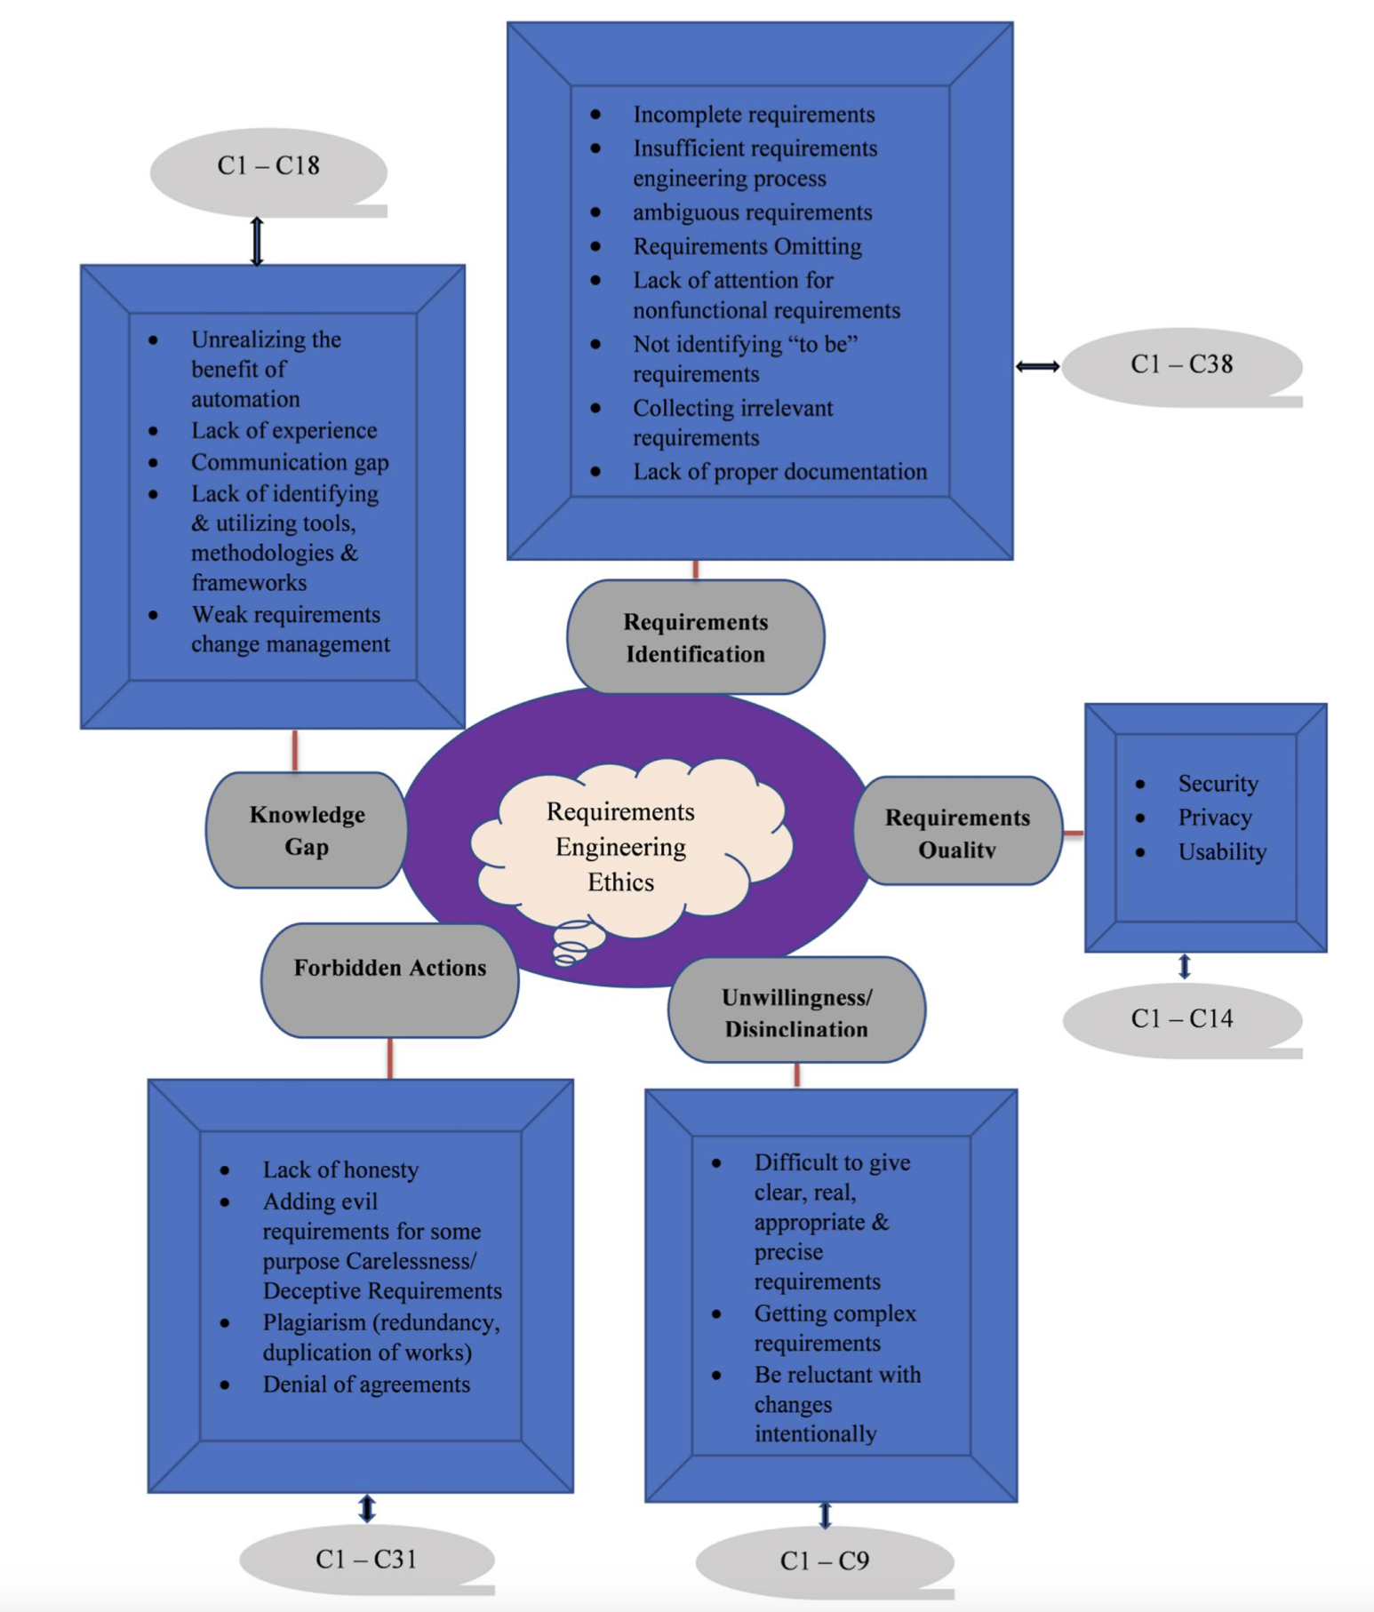
Proposed ethical framework for RE
Used as a practical guideline in Five Core Categories:
1- Ethics for Knowledge Gap (18 clauses)
  Address lack of automation awareness, weak communication, and inadequate training.
2- Ethics for Requirements Identification (38 clauses)
  Guidance for avoiding ambiguous, omitted, or irrelevant requirements.
3- Ethics for Requirements Quality (14 clauses)
  Ensure security, privacy, and usability are ethically managed.
4- Ethics for Unwillingness/Disinclination (9 clauses)
  Encourage transparency and participation from reluctant stakeholders.
5- Ethics for Forbidden Actions (31 clauses)
  Prevent dishonesty, plagiarism, deception, and unethical behaviour.
Validated by 40 software professionals (industry+academia) via questionnaire, focus groups and discussions
Biable, Seblewongel E., Nuno M. Garcia, and Dida Midekso. "Proposed ethical framework for software requirements engineering." IET Software 17.4 (2023): 526-537
Notes:
Can be used as a practical guideline
110 clauses
a list of clauses given as specific advice to minimise the occurrence of the corresponding identified ethical concerns

